Slide 1
Plano West Swim and Dive

Slide 2
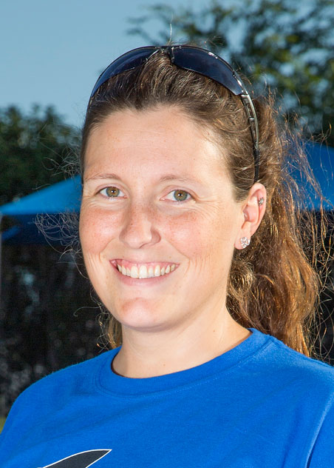
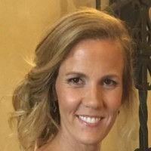
Coach Allison allison.looney@pisd.edu & Coach Poland amanda.poland@pisd.edu

Slide 3
Board Structure
Tricia Hunsucker
Co-chair of Celebrations
Michelle Heil
Vice President Volunteers
Rosolayn Johnson
C0-chair of Celebrations
Ricki Dworkin
Co-Chair Team Spirit
Laura Fitzgibbon
President
Lil Cai
Co-Chair Team Spirit
Stefanie Meaders Secretary/Vice President Communications
Janet Smith
Chair Communications
Elke Harrison
Treasurer
Carolyn Filak
Chair Fundraising

Slide 4
Purpose of Booster Club
Support the swimmers and divers of the Plano West Swim and Dive Team
Support the coaches of the Plano West Swim and Dive Team
Foster Team Spirit by encouraging parent and community participation
Raise funds to facilitate the above

Slide 5
Primary Communication via Website
Important Updates, calendar, contact info, photos, meet results
www.planowestswim.org

Slide 6
Daily Reminders and Social Media
Facebook at Plano West Swimming Booster Club
Daily Remind Texts from Coach Bobo: Text the following code to 81010
Varsity code is @72cbek
Junior Varsity code is @8f764a

Slide 7
Activity Fee = $225
1 team suit
3 team shirts
Swim Book
Team caps for champs meets
2 Team Posters
Meet snacks (meals for all day meets)
Banquet Fee for 1 swimmer/diver
Remainder to misc. items direct to swimmers

Slide 8
Missing Size Info
Allam, Elsa – Pant size
Chen, Josh – suit, pant and jacket sizes
Gayake, Saket – jacket and pant size
Gonzalez, Leonardo – suit, pant and jacket size
Hunt, Theresa – suit, jacket and pant size
Moon, Michell – suit jacket and pant size
Olvera, Steven – suit, pant and jacket size
Xu, Michael – suit, jacket and pant size
Zhang, George – suit, pant and jacket size

Slide 9
Amazon Smile
Amazon will give a percentage of all sales to the swim team if you use their Amazon Smile site for your purchases – no difference in products or prices.
Simply go to www.smile.amazon.com
Select Plano West High School Booster Club Swim & Dive Team from the search box for your charitable organization
SHOP!

Slide 10
Attendance
Contact coach if you are going to be absent
Not eligible for meet if miss practice immediately before a meet
Bus trips
Prelims/Finals meets
This is a grade

Slide 11
Black and Blue Meet, Sept 15 from 10am to 1pm
Family Fun
Intra-squad Fun Competition
Start with Team Pictures at 10am
LifeTime Fitness
Order food ahead online

Slide 12
Volunteer
Checkout the sign-up sheets in back – our team does not function without you!
Certified Officials
Timers
Market Day spirit wear sales
Food delivery for swim meets
Banquet planning
Dinner hosts
Photographers

Slide 13
Dual Home Meet - Parents
Heat Sheet Sales
Announcer
Time System Operators
Head Timer
Timers
Water for Volunteers – 2 cases on ice/distribute
UIL Officials

Slide 14
Dual Home Meet Swimmers
JV warm-up at normal practice time
Varsity warm-up at 4:30
Meet starts at 6pm
Usually go 3-4 hours
2 individual events and 2 relays or 1 individual events and 3 relays (maximum)
Granola bars provided for home meets but bring own water or other snacks

Slide 15
Championship and Qualifying Meets
TISCA - Nov
Dallas Cup - Nov
Districts
JV Champs
Regionals
State

Slide 16
Events
Team Meet Dinners – swimmers only
Charity – walk or other
Parade – Oct 29
Black and Blue – Sept 15, families
Team Dinners – Fall and Holiday, swimmers
Banquet, families
Parent Social, parents or guardians only

Slide 17
Spiritwear
Many exciting items available.
Some on hand – others can be ordered tonight
Through our website store
or through Xtremeswim.com portal PWSH is our code
Letter Jackets will be available for purchase in the spring to fourth year swimmers and to those who score points at districts.

Slide 18
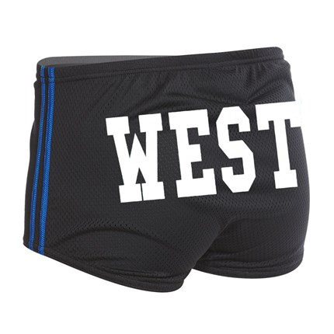
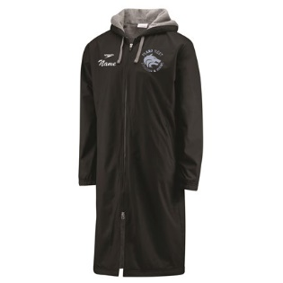
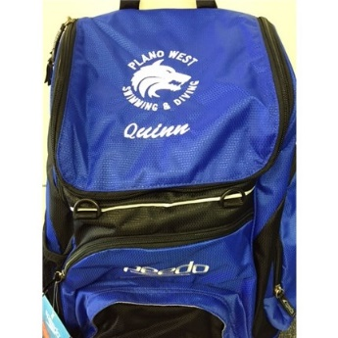
Spirit Product Samples

